Slide 1

ATTENTIVENESS WITH ATTENDANCE SURVEY MODEL USING FACE RECOGNITION
By- Chandana Mn Harshavarthini m Ankita v patil Neha kumari
Under the guidance of - Dr Harinath Aireddy

Slide 2
Abstract:
•The conventional method of taking attendance is done manually by the teacher or the administrator which requires considerable amount of time and efforts also involving errors and proxy attendance.
•In this drastic increase in number of students it will be hard for to teachers to give attention to all the students at once and keep eye on every student.
•Based on the training given to the model it will predict the attentiveness of students which help relation between student and facility
•This can be used as a type of feedback which will help the teacher to improve their teaching strategies based on students' expression in class and it also help teachers to give feedback on students. It will help both students and teacher to improve.

Slide 3
Aim:
To reduce the manual work of taking attendance.
Save time and energy of teachers.

Slide 4
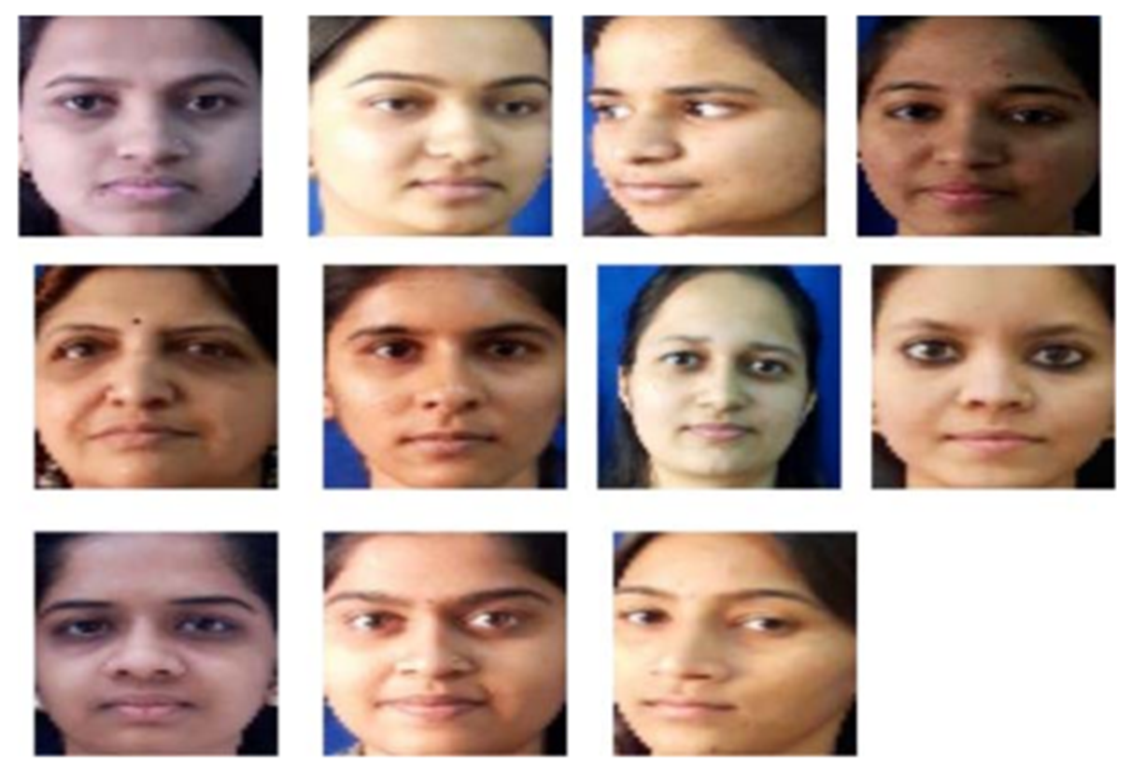
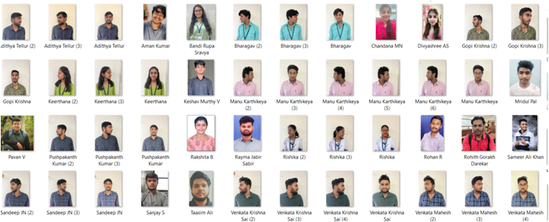
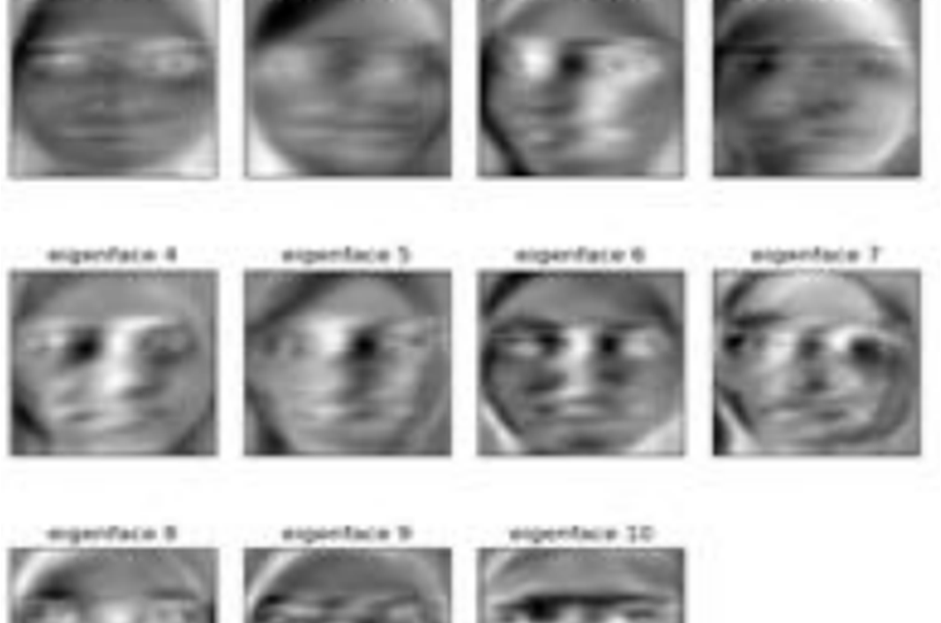
Proposed system:
A. INPUT

Slide 5
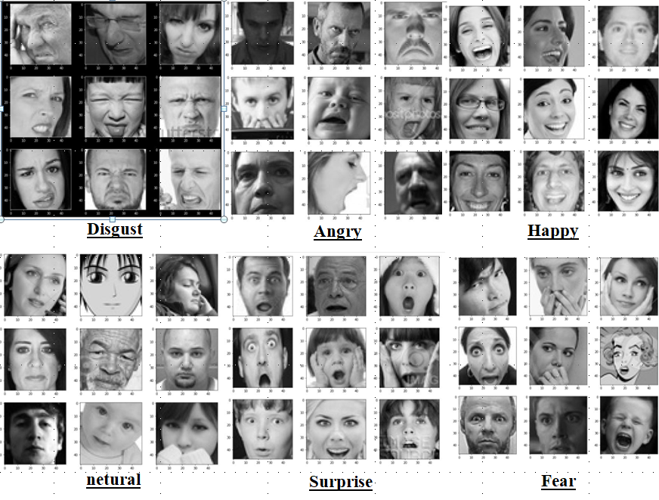
Facial expression recognition Dataset

Slide 6
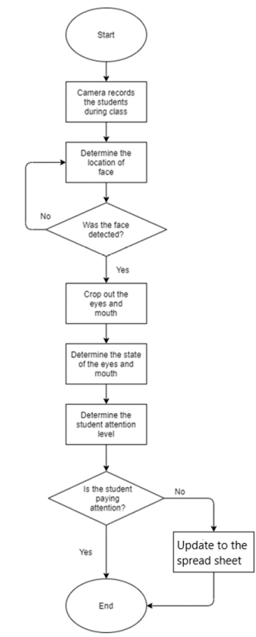
Flow chart:

Slide 7
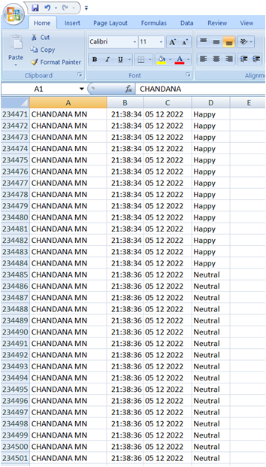
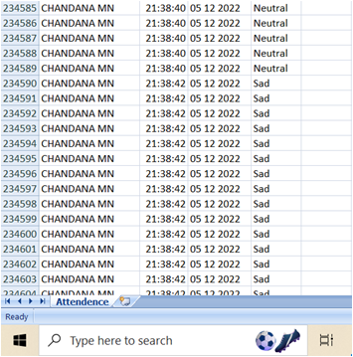
c. output

Slide 8
SummAry:
The number of students are significant and by using conventional method of taking attendance will lead to considerable time consumption and amount of manual work gets increased significantly.
It provides accuracy.
The number of students are significant and by using facial expression recognization predicts the students attentiveness in class

Slide 9
References
•Automated Attendance System using Machine Learning Approach Hemantkumar Rathod, Yudhisthir Ware, Snehal Sane, Suresh Raulo, Vishal Pakhare and Imdad A. Rizvi Department of Electronics and Telecommunication Engineering, Terna Engineering College, Navi Mumbai, Maharashtra, INDIA
•Face Recognition Based Attendance System Using Machine Learning Algorithms Radhika C. Damale Department of Electronics and Telecommunication Cummins College of Engineering for Women Pune, Maharashtra, India radhika.damale@cumminscollege.in Prof.Bageshree.V.Pathak Department of Electronics and Telecommunication Cummins College of Engineering for Women Pune, Maharashtra, India bageshree.pathak@cumminscollege.in
•FaceTime – Deep Learning Based Face Recognition Attendance System Marko Arsenovic, Srdjan Sladojevic, Andras Anderla, Darko Stefanovic University of Novi Sad, Faculty of Technical Sciences, Novi Sad, Serbia arsenovic@uns.ac.rs, sladojevic@uns.ac.rs, andras@uns.ac.rs, darkoste@uns.ac.rs
Smart Attendance System Using Face Recognition -FP-International Journal of Computer Science Research (IJCSR) Volume 2, Issue 2, Pages 68-72, June 2015 68 Chaudhari Sagar P Pravara Rural Engineering College, Loni Rahata, Ahmednagar, (M.S.) Kulkarni Satyajit Devidas Pravara Rural Engineering College, LoniRahata, Ahmednagar, (M.S.) Prof G.R Surawanshi Pravara Rural Engineering College, Loni Rahata, Ahmednagar, (M.S.)
Face Detection and Recognition Based on Visual Attention Mechanism Guidance Model in Unrestricted Posture -School of Mechanical and Electrical Engineering, Guangdong Industry Polytechnic, Guangzhou, China Correspondence should be addressed to Zhenguo Yuan; 2016001053@gdip.edu.cn Received 14 April 2020; Revised 28 April 2020; Accepted 6 May 2020; Published 20 May 2020 Academic Editor: Chenxi Huang

Slide 10


